Slide 1

Unit 6:Distributed Memory Architecture.
Point 3–Interconnection Networks-Time shared /Common buses
Dr. Mrs Mamata Sachin Kalas
Email id:kalas.mamta@kitcoek.in

Slide 2
Interconnection networks
Time shared /common bus.
Crossbar switch and multiport memories.
Interconnection Networks-Time shared common bus

Slide 3
Time shared common bus
It is totally passive unit and the transfer operations are completed by bus interface.
Types:
Single Bus organization.
Unidirectional bus organization.
Multi-bus organization.
Interconnection Networks-Time shared common bus

Slide 4
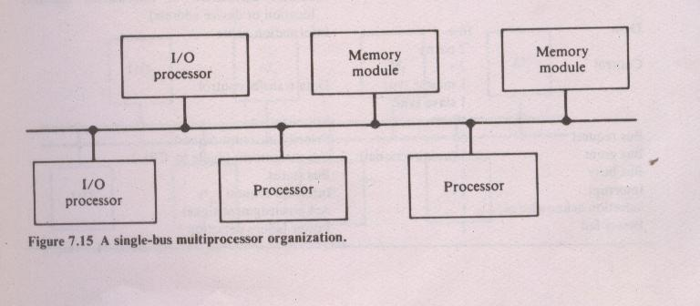
Single Bus organization.
It is reliable and inexpensive.
Drawbacks:
central point of failure.
system expansion results in increased bus contention.
Transfer rate limited by bandwidth and speed of the single path.
Interconnection Networks-Time shared common bus

Slide 5
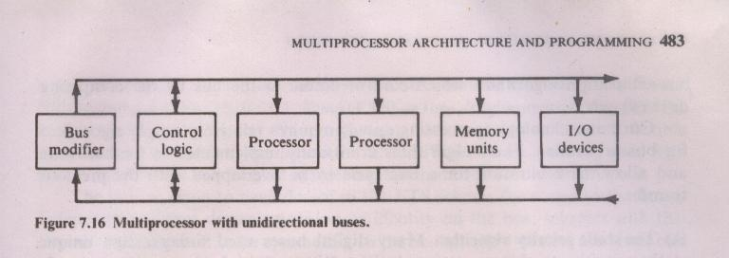
Unidirectional bus organization.
Two separate unidirectional buses are used.
In single data transfer both the buses are involved.
Interconnection Networks-Time shared common bus

Slide 6
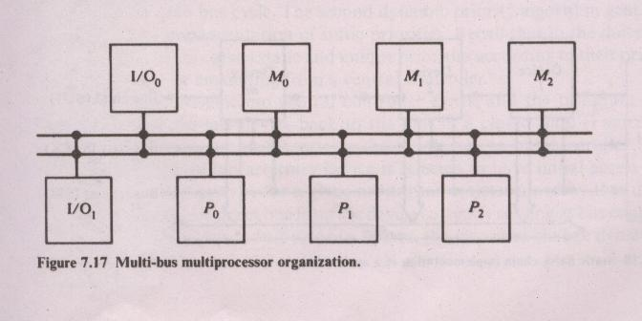
Multi-bus organization
Multiple bidirectional buses are provided to allow simultaneous data transfers.
It increases complexity of the system.
Interconnection Networks-Time shared common bus

Slide 7
Bus Arbitration algorithm
Bus arbitration algorithm control access to the bus by the competing devices.
The static priority algorithm
The fixed time slice algorithm
Dynamic priority algorithm
The first come first served algorithm
Independent request implementation
Polling implementation
Interconnection Networks-Time shared common bus

Slide 8
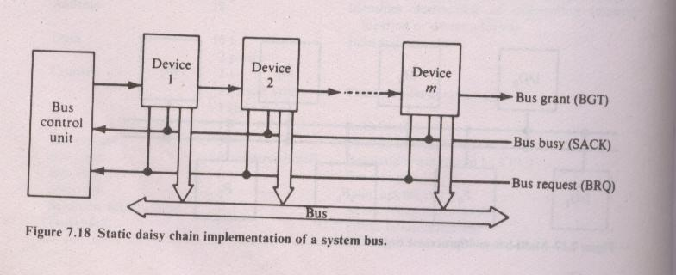
The static priority algorithm
Interconnection Networks-Time shared common bus

Slide 9
The static priority algorithm-Daisy Chaining
When multiple devices concurrently request the use of bus, the device with the highest priority is granted access to it.
In this scheme, all services effectively assinged static priorities according to their locations along bus grant control line.
Request are made on common request line BRQ
The central bus control unit propagates bus grant signal (BGT) if the acknowledged signal indicates the bus to be idle.
Interconnection Networks-Time shared common bus

Slide 10
The fixed time slice algorithm
The available bus bandwidth is divided into fixed length time slices
Time slices are sequentially offered to each device in round robin fashion.
All m devices are given one out of every time slices at fixed intervals.
Interconnection Networks-Time shared common bus

Slide 11
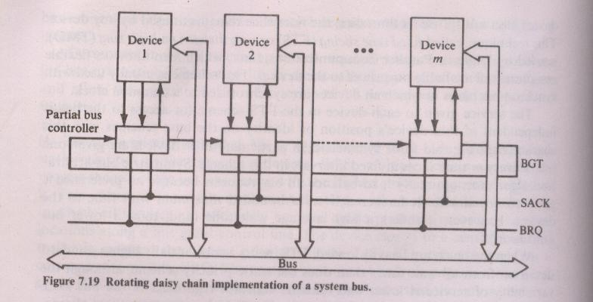
Dynamic priority algorithm
Interconnection Networks-Time shared common bus

Slide 12
Dynamic priority algorithm
Dynamic priority algorithm allow the load balancing characteristics to be achieved without incurring the penalty of high wait times.
The devices are assigned unique priorities and compete to access the bus, but the priorities are dynamically changed.
Two algorithms are used - 1) LRU : Least recently used 2) RDC : Rotating daisy chain
LRU gives highest priority to the requesting device that has not used the bus for the longest interval.
RDC generalizes the daisy chain implementation of static priorities.
In RDC scheme, no central controller exists. The bus grant line is connected from the last device back to the first.
Interconnection Networks-Time shared common bus

Slide 13
The First come first served algorithm
In FCFS scheme, the requests are simply processed in the order received.
This scheme is symmetric because it favors no particular processors/device on the bus.
It gives smallest possible average wait time and standard deviation of all wait times.
Interconnection Networks-Time shared common bus

Slide 14
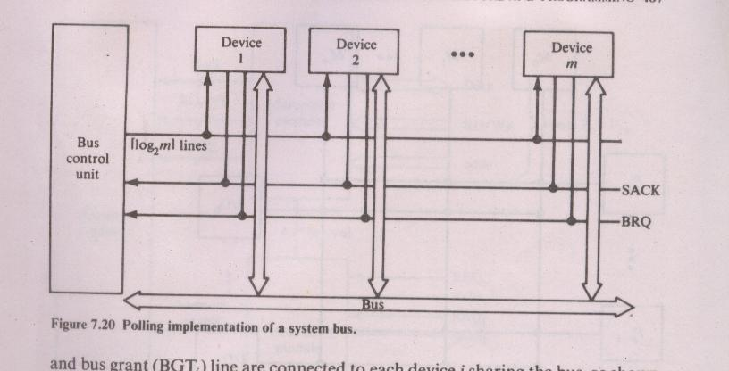
Polling implementation
Interconnection Networks-Time shared common bus

Slide 15
Polling implementation
In this bus grant signal (BGT) of static daisy chain implementation is replaced by set of log2m polling lines.
The set of poll lines is connected to each of the devices.
On a bus request, the controller sequences through the device addresses using poll lines.
When a device Di requested access recognizes its address, it raises the SACK line.
Priority is determined by position of the device in the polling sequence.
Interconnection Networks-Time shared common bus

Slide 16
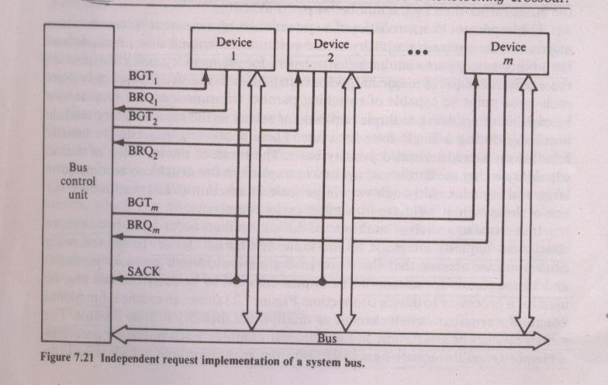
Independent request implementation
Interconnection Networks-T<number><number>ime shared common bus

Slide 17
Independent request implementation
In this, a separate bus request BRK, and bus grant BGT lines are connected to each device i sharing the bus.
This technique permits implementation of LRU, FCFS and other allocation algorithms.
Interconnection Networks-Time shared common bus

